Slide 1
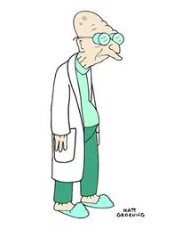
COMP24111 lecture 5
Experiments in Machine Learning
100
90
Accuracy
(%)
80
70
A
B
C
D
Learning algorithm

Slide 2
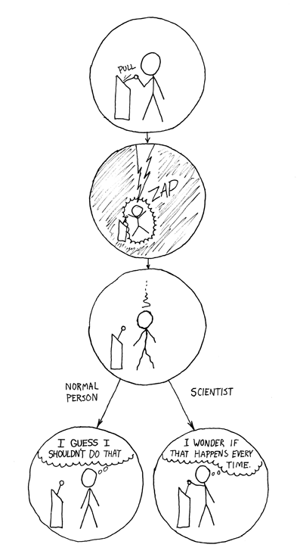
Scientists
vs
Normal People

Slide 3
Learning Algorithm
Split our data randomly
Train a model…
Test it!
Why do we split the data?

Slide 4
The Most Important Concept in Machine Learning…
Looks good so far…

Slide 5
The Most Important Concept in Machine Learning…
Looks good so far…
Oh no! Mistakes!
What happened?

Slide 6
The Most Important Concept in Machine Learning…
Looks good so far…
Oh no! Mistakes!
What happened?
We didn’t have all the data.
We can never assume that we do.
This is called “OVER-FITTING”
to the small dataset.

Slide 7
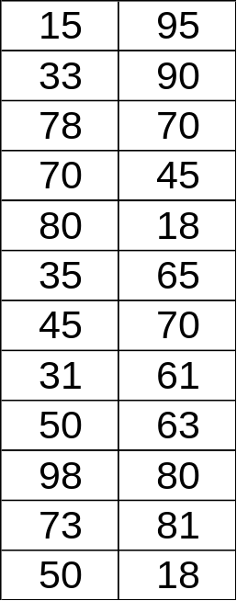
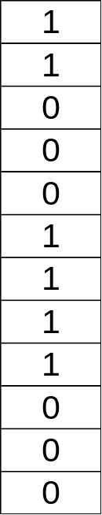
Inputs
Labels

Slide 8
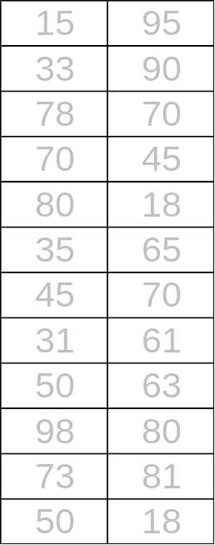
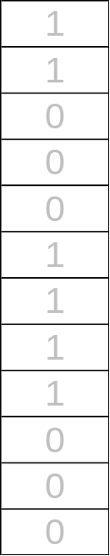
15 | 95
33 | 90
78 | 70
70 | 45
80 | 18
35 | 65
1
1
0
0
0
1
Inputs
Labels
50:50
(random)
split
45 | 70
31 | 61
50 | 63
98 | 80
73 | 81
50 | 18
1
1
1
0
0
0

Slide 9
Ideally should be small.
Smaller is better.
But if too small... you’ll make many mistakes on the testing set.
15 | 95
33 | 90
78 | 70
70 | 45
80 | 18
35 | 65
1
1
0
0
0
1
Training set
Train a K-NN or Perceptron on this…
45 | 70
31 | 61
50 | 63
98 | 80
73 | 81
50 | 18
1
1
1
0
0
0
Testing set
… then, test it on this!
“simulates” what it might be like to see new data in the future
Needs to be quite big.
Bigger is better.

Slide 10
Training set
Build a model (knn, perceptron, decision tree, etc)
Testing set
How many incorrect predictions on testing set?
Percentage of incorrect predictions is called the “error”
e.g. “Training” error
e.g. “Testing” error

Slide 11
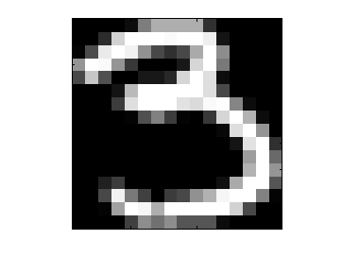
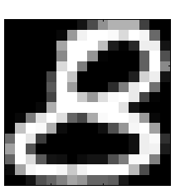
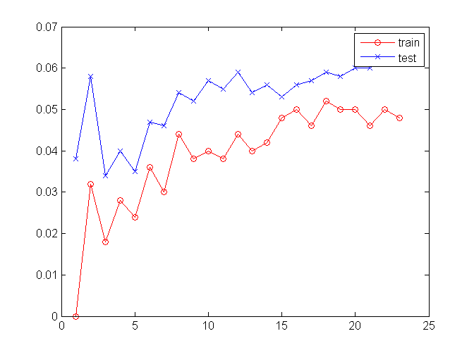
Classifying ‘3’ versus ‘8’ digits
Plotting error as a function of ‘K’ (as in the K-NN)
error
K
Training data can behave very differently to testing data!
Percentage of incorrect predictions is called the “error”
e.g. “Training” error
e.g. “Testing” error

Slide 12
Which is the “best” value of k?
Different random split of the data
= different performance!
100
90
Accuracy
(%)
80
70
1
3
5
7
K value used in knn classifier
MATLAB: “help errorbar”

Slide 13
Error bars (a.k.a. “confidence intervals”)
Plots the average, and the standard deviation (spread) of values.
Wider spread = less stability….
100
90
Accuracy
(%)
80
70
1
3
5
7
K value used in knn classifier
MATLAB: “help errorbar”

Slide 14
MATLAB: “help crossfold”
Cross-validation
We could do repeated random splits… but there is another way…
Break the data evenly into N chunks
Leave one chunk out
Train on the remaining N-1 chunks
Test on the chunk you left out
Repeat until all chunks have been used to test
Plot average and error bars for the N chunks
All data
5 chunks
Train on these
(all together)
Test on this
… then repeat, but test on a different chunk.

Slide 15
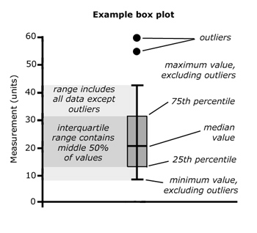
Box-plots
Reflects shape of true distribution more accurately.
MATLAB: “help boxplot”

Slide 16
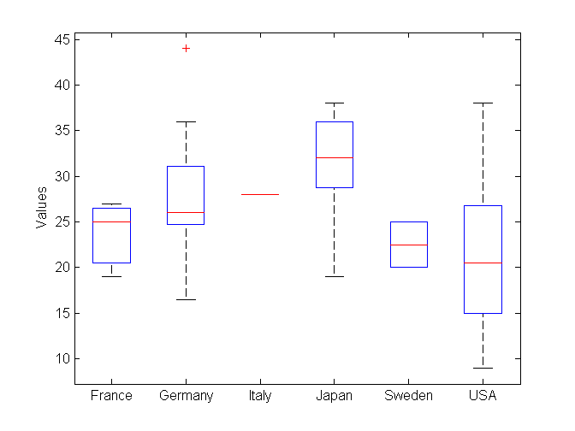
Most datapoints clustered high (around 30-35)
Wide confidence intervals, but slight skew downward, (around 15-25)
MATLAB: “help boxplot”

Slide 17
What factors should affect our decision?
Accuracy
  - How accurate is it?
Training time and space complexity
  How long does it take to train?
  How much memory overhead does it take?
Testing time and space complexity
  How long does it take to execute the model for a new datapoint?
  How much memory overhead does it take?
Interpretability
  - How easily can we explain why it does what it does?
100
90
Accuracy
(%)
80
70
A
B
C
D
Learning algorithm

Slide 18
Measuring accuracy is not always useful…
Accuracy
  - How accurate is it?
Training time and space complexity
  How long does it take to train?
  How much memory overhead does it take?
Testing time and space complexity
  How long does it take to execute the model for a new datapoint?
  How much memory overhead does it take?
Interpretability
  - How easily can we explain why it does what it does?
100
90
Accuracy
(%)
80
70
A
B
C
D
Learning algorithm

Slide 19
Best testing error at K=3, about 3.2%.
Is this “good”?

Slide 20
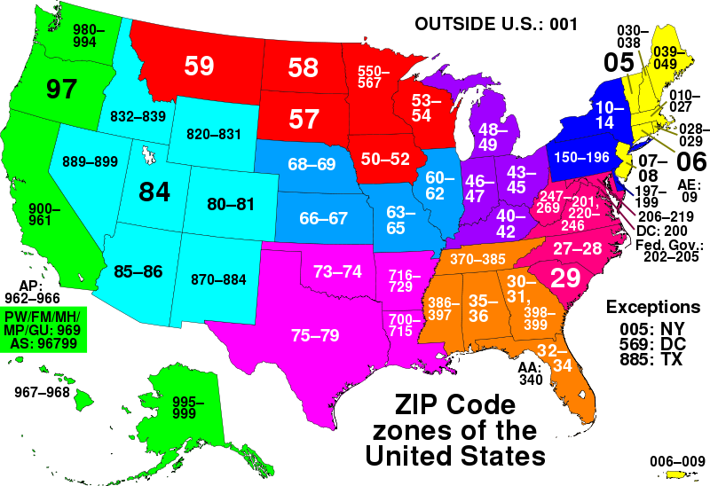
Zip-codes: “8” is very common on the West Coast, while “3” is rare.
Making a mistake will mean your Florida post ends up in Las Vegas!

Slide 21
Sometimes, classes are rare, so your learner will not see many of them.
What if, in testing phase you saw 1,000 digits ….
32 instances
968 instances
3.2% error was achieved by just saying “8” to everything!

Slide 22
Solution?
32 instances
968 instances
0% correct
100% correct
Measure accuracy on each class separately.

Slide 23
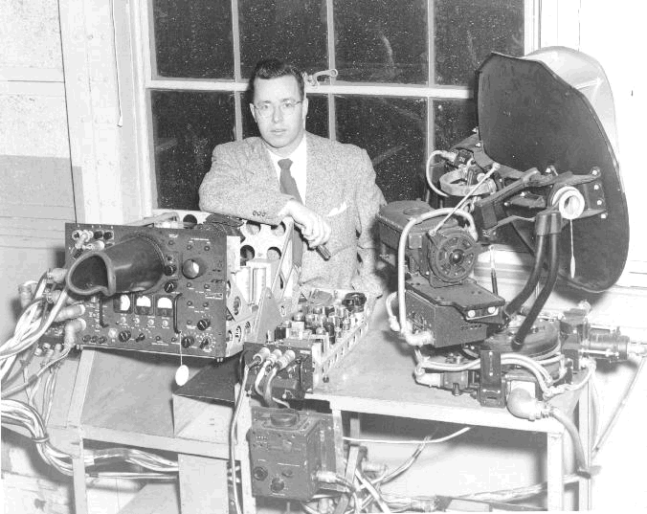

ROC analysis
32 instances
968 instances
Our obvious solution is in fact backed up a whole statistical framework.
Receiver Operator Characteristics
Developed in WW-2 to assess radar operators.
“How good is the radar operator at spotting
incoming bombers?”
False positives
– i.e. falsely predicting a bombing raid
False negatives
– i.e. missing an incoming bomber (VERY BAD!)

Slide 24
ROC analysis
The “‘3” digits are like the bombers.
Rare events but costly if we misclassify!
False positives – i.e. falsely predicting an event
False negatives – i.e. missing an incoming event
Similarly, we have “true positives” and “true negatives”
Prediction
0 1
TN | FP
FN | TP
0
1
Truth

Slide 25
Building a “Confusion” Matrix
Prediction
0 1
TN | FP
FN | TP
0
1
Truth
TP
Sensitivity =
… chances of spotting a “3” when presented with one (i.e. accuracy on class “3”)
TP+FN
TN
… chances of spotting an 8 when presented with one (i.e. accuracy on class “8”)
Specificity =
TN+FP

Slide 26
ROC analysis… your turn to think…
TP
TN
Sensitivity = = ?
Specificity = = ?
TP+FN
TN+FP
Prediction
0 1
60 | 30
80 | 20
60+30 = 90 examples in the dataset were class 0
0
1
Truth
80+20 = 100 examples in the dataset were class 1
TN | FP
FN | TP
90+100 = 190 examples in the data overall

Slide 27
ROC analysis – incorporating costs…
FP = total number of false positives I make on the testing data
FN = total number of false negatives I make on the testing data
Useful if one is more important than another. For example if a predictor…
… misses a case of a particularly horrible disease (FALSE NEGATIVE)
or
… sends a patient for painful surgery when it is unnecessary (FALSE POSITIVE)

Slide 28
Experiments in Machine Learning
Learning algorithms depend on the data you give them
  some algorithms are more “stable” than others
  must take this into account in experiments
  cross-validation is one way to monitor stability
  plot confidence intervals!
ROC analysis can help us if…
  there are imbalanced classes
  false positives/negatives have different costs

